Slide 1



SUSTAINABLE SUPPLY CHAIN PERFORMANCE DASHBOARD
Enhancing Transparency and Efficiency for Future-Ready Operations
NAME : Sk Arsh
AICTE Student ID: STU662f7a125fee01714387474

Slide 2

Learning Objectives
Understand key supply chain metrics and their significance.
Utilize Power BI for data-driven decision-making.
Analyze supplier performance and production efficiency.
Evaluate sales trends, revenue generation, and cost management.
Optimize inventory, logistics, and transportation strategies.
Enhance overall supply chain performance with actionable insights.
GOAL
Source :
www.freepik.com/

Slide 3
Tools and Technology used
Power BI: Interactive dashboards and data visualization.
Excel: Data preprocessing and analysis.
DAX (Data Analysis Expressions): Advanced calculations in Power BI.
Power Query: Data transformation and cleaning.

Slide 4
Methodology
Data Collection: Gathered supply chain data, including SKU, revenue, customer demographics, supplier details, and logistics.
Data Cleaning & Preparation: Used Power Query and Excel to clean and format the data, ensuring accuracy and consistency.
Data Modeling: Structured relationships between tables in Power BI for better analysis.
Visualization Development: Created interactive charts and dashboards using Power BI to present key supply chain insights.
Analysis & Interpretation: Evaluated trends and patterns in supply chain performance to provide actionable insights.
Refinement & Validation: Ensured that the visualizations accurately represented the data and aligned with business objectives.

Slide 5
Problem Statement:
Lack of Real-Time Supply Chain Insights: Difficulty in monitoring supply chain performance due to fragmented data sources.
Inefficient Supplier and Production Management: Challenges in evaluating supplier performance and production efficiency.
Inventory and Stock Level Challenges: Difficulty in optimizing stock levels and preventing overstocking or stockouts.
High Transportation and Logistics Costs: Need to analyze and reduce transportation expenses.
Revenue and Cost Analysis Complexity: Lack of clear visibility into the impact of costs on revenue generation.
Customer Demographics and Market Segmentation Issues: Need to understand customer preferences and target markets effectively.

Slide 6
Solution:
Real-Time Data Integration: Using Power BI to consolidate data from various sources for real-time analysis.
Supplier & Production Performance Metrics: Implementing matrix charts to evaluate supplier contributions and efficiency.
Optimized Inventory Management: Using clustered column charts to track stock levels and order quantities.
Cost Reduction Strategies: Identifying high-cost transportation modes using pie charts and optimizing logistics.
Revenue and Cost Analysis Visualization: Employing waterfall charts to assess the impact of costs on revenue generation.
Customer-Centric Analysis: Utilizing demographic filters and segmentation tools to understand customer behavior and target markets effectively.

Slide 7
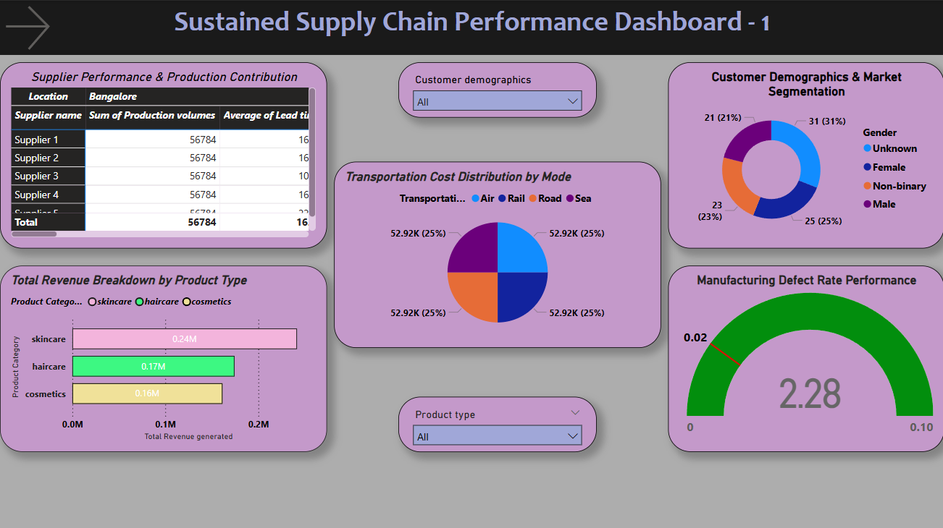
Screenshot of Output:

Slide 8
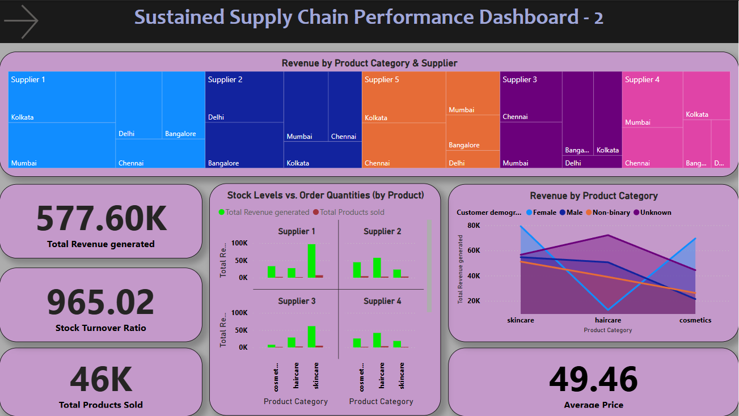
Screenshot of Output:

Slide 9
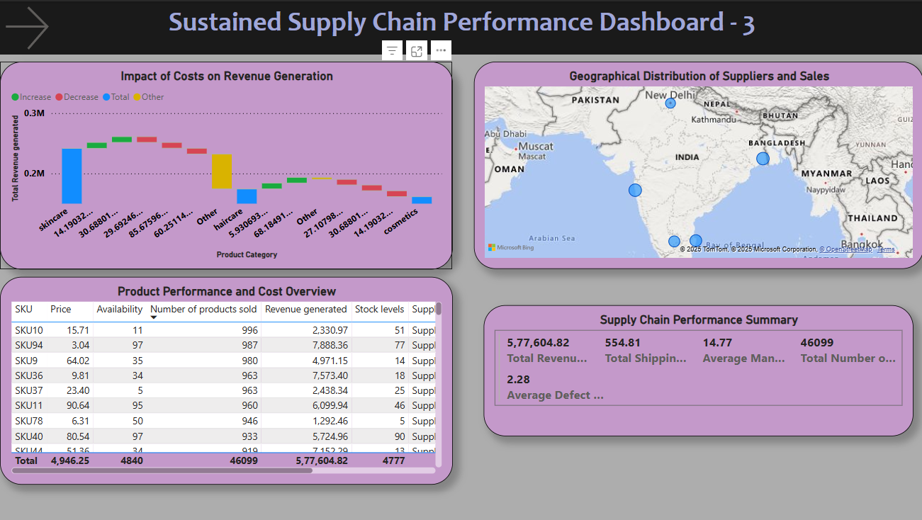
Screenshot of Output:

Slide 10
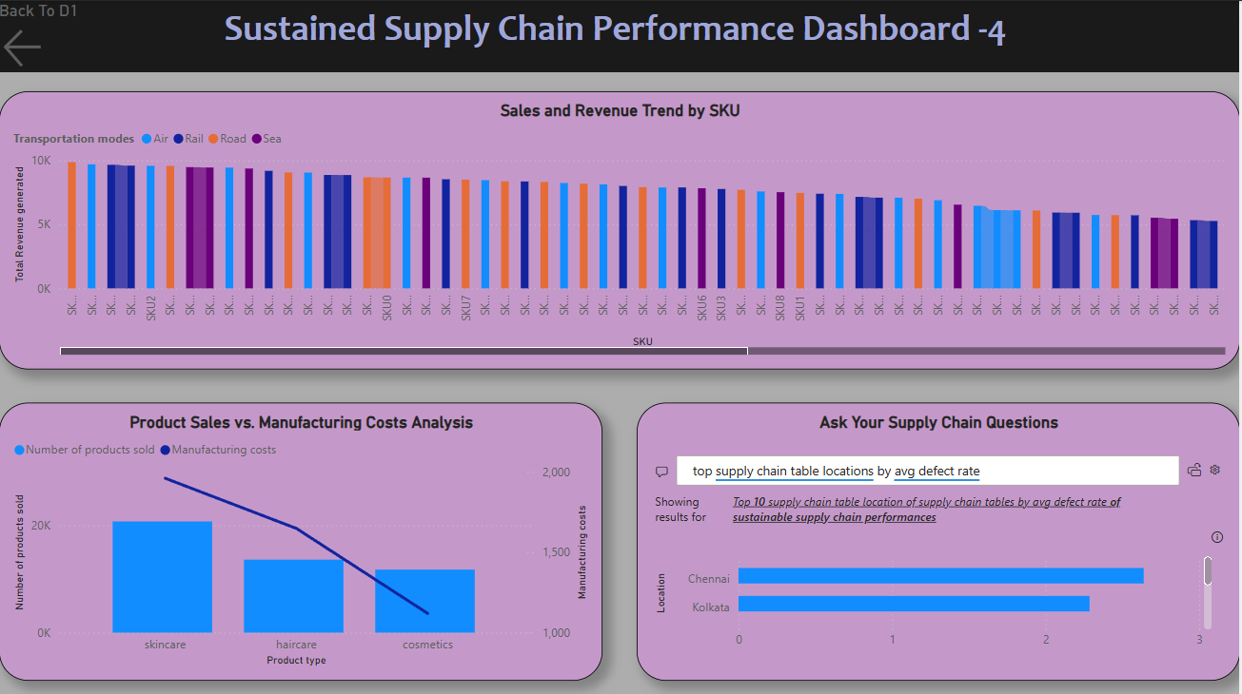
Screenshot of Output:

Slide 11
Conclusion:
Data-Driven Decision-Making: Utilizing Power BI provides actionable insights to optimize supply chain performance.
Efficiency & Cost Savings: Streamlining inventory, logistics, and supplier evaluation results in reduced costs and improved efficiency.
Customer Insights for Growth: Understanding customer demographics and preferences helps in targeted marketing and sales growth.
Scalability & Sustainability: Implementing a data-driven approach ensures long-term sustainability and business scalability.
Power BI as a Game-Changer: This tool empowers businesses to analyze and respond to supply chain challenges effectively.

